Slide 1

BOOK STORE MANAGEMENT SYSTEM
Ranjit kadam
Siddhesh kaware
Prathamesh kulkarni

Slide 2
A SYSTEM - DESCRIPTION
This system is management by an administrator .He has all the administrative right ton perform all the required functionalities.
Customers can search for a particular book whether it is available or not in a store . The search result contain information regarding book availability , price, publication ,authors and number of page
Admin keeps track on the quantity of books . Whenever required , he puts an order for purchasing new books to supplier .
A book store management system manages data regarding books , customers , employees , suppliers ,and other relevant purchase & sale related data .

Slide 3
A SYSTEM - DESCRIPTION
To support this task , minimum quantity (or reorder quantity ) is managed for each book along with other data.
Whenever supplier supplies order stock are updated and bill – data related to support to supplier is stored.
Related to each sale , a computerized bill is generated for a customer . Based on selling ,quantity is updated ( subtracted ) for sold books automatically .
Whenever required ,admin can search data related to some particular customers ,employees or suppliers.

Slide 4
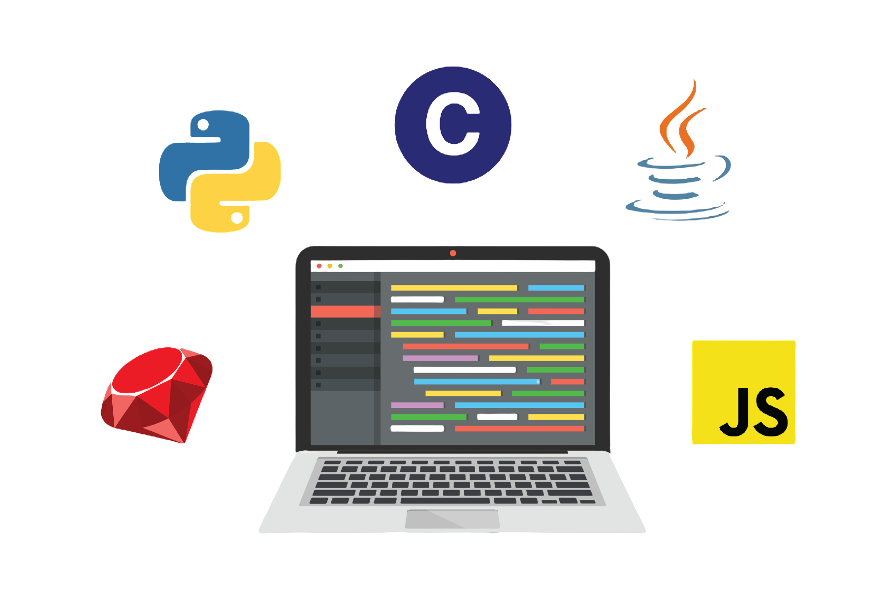
LANGUAGES & TOOLS
HTML
CSS
PYTHON
SQLite3
DJango

Slide 5
MAIN OPERATIONS
1.MANAGE BOOK DATA
2.MANAGE CUSTOMER DATA
3.MANAGE EMPOYLEE DATA
4.MANAGE SUPPILER DATTA
5.MANAGE SALE
6.MANAGE PURCHASE
7.SEARCH BOOK BY NAME ,WRIITER AND CATEGORY
8.LOGIN AND LOGOUT FACILITY

Slide 6
MANAGE BOOK DATA
ADD BOOK
Adds/Insert data related to new book
Input : data related to new book
Modify book
Modifies data related to existing book
Input search keyword, modifications
Remove book
Removes data related to existing book
Input :search keyword
Search book
Search for a book based on given keywords
Input : search keyword
Output : book id, title ,author ,price ,page edition..

Slide 7
MANAGE SALES
Receive order
Receives order from customer
Input : book detail , quantity
Prepare bill
Calculate total prices and grand total, generates customers bill
Input : book detail , quantity ,customer detail
Output : printed bill
Update stock
Updates stock based on quantity of sold books
Input : book detail , quantity

Slide 8
MANAGE PURCHASE
Prepare & send order
Finds out books to be reordered ,gets supplier details details , prepare order , sends order
Input : book detail to be reordered ,supplier data
Output :printed order
Update stock
Checks delivered books , updates stock based on quantity of delivered books
Input : delivered book data with quantity
Manage supplier bill
Stores data related to bill given by a supplier
Input : supplier bill data

Slide 9
PROJECT FEATURE DESCRIPTION

Slide 10
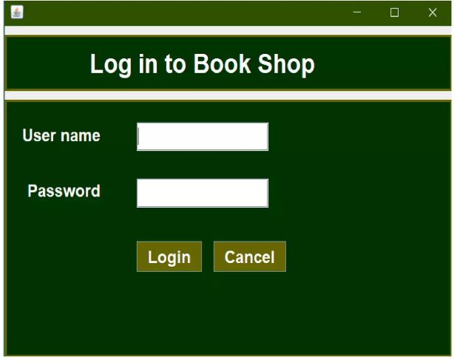
LOGIN WINDOW
ENTER USERNAME AND PASSWORD .IF WRONG VALUE IS ENTERED ,ITS SHOWS ERROR MESSAGE OTHERWISE , IT RUNS THE MAIN WINDOW

Slide 11
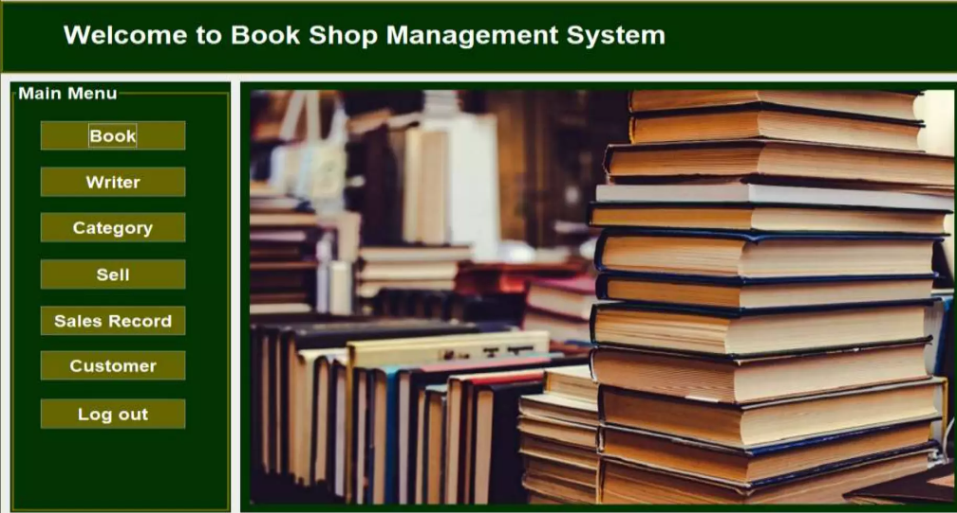
MAIN WINDOW
After successful login ,the main window will be shown

Slide 12
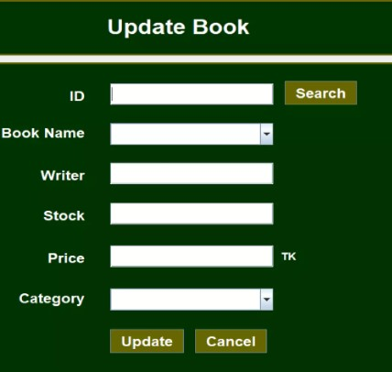
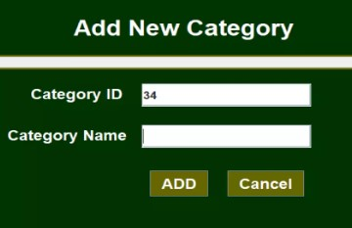
MANAGING BOOK
In this window , user can updated a book
In this window , user can add a new category of book

Slide 13
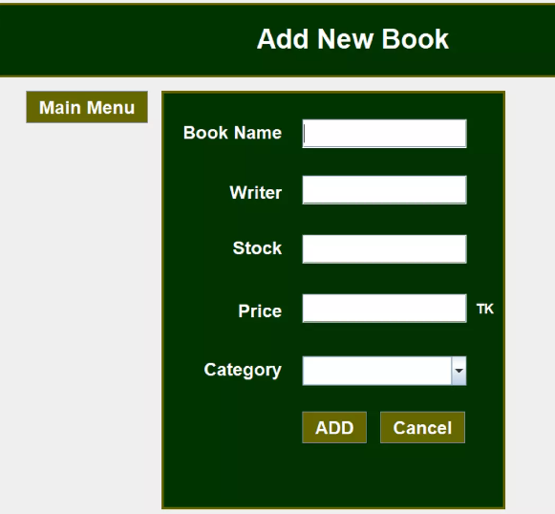
MANAGING BOOKS
In this window , user can add new book.

Slide 14
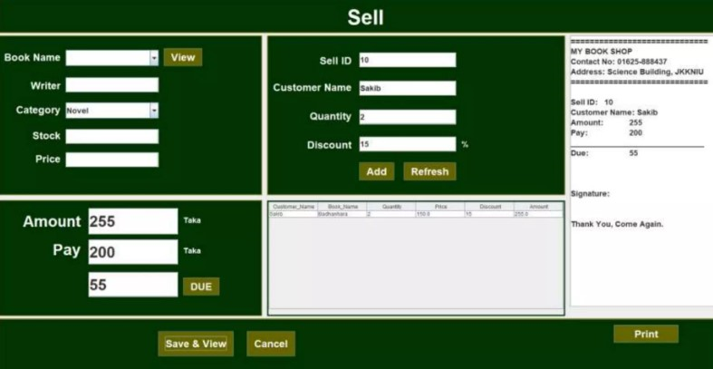
SELL BOOKS
This window is used to sell books

Slide 15
ADVANTAGE
Less time to search for the specified book .
Savings in stationary .
Proper and clean work .
Better search ability and availability .

Slide 16
CONCLUSION
This software is successfully done to maintain a book shop transaction .
The project is completed that follow the incremental model

Slide 17
THANK YOU..!

